Slide 1
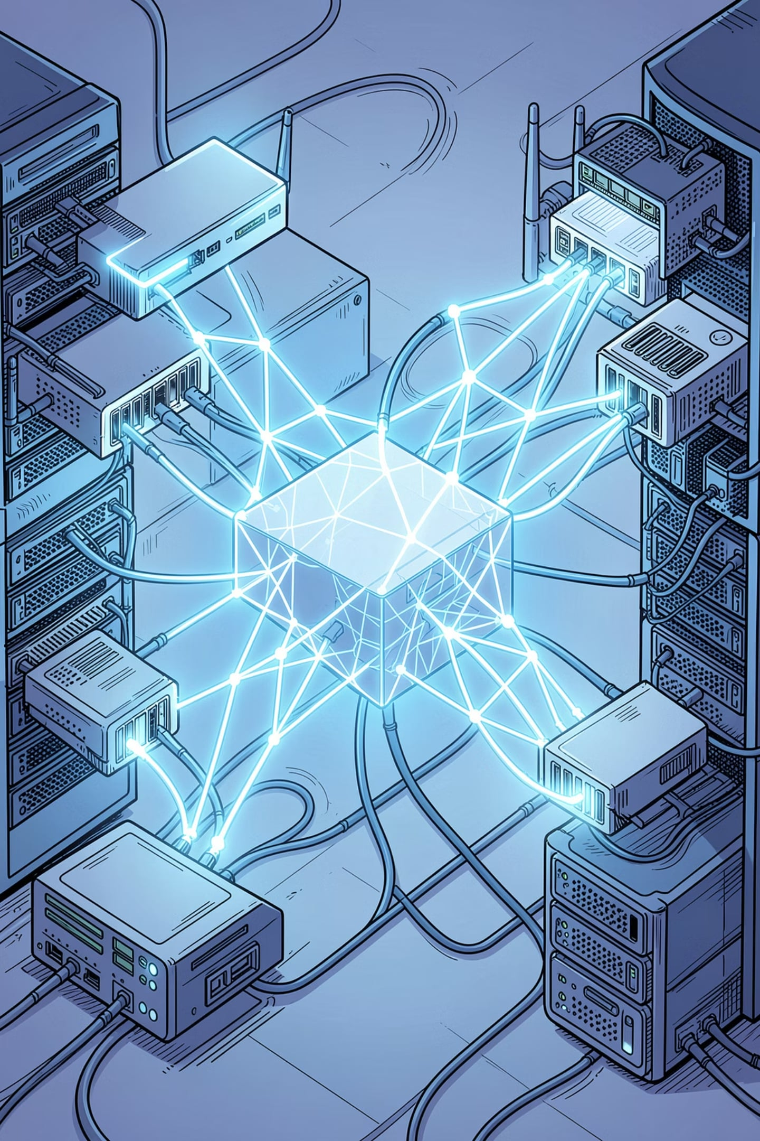
Machine Learning-Based Error Detection in Networks
Technical presentation — Computer Networks
Presenter: Vasireddy Sree Ruthin Reddy
Regno-192324112

Slide 2
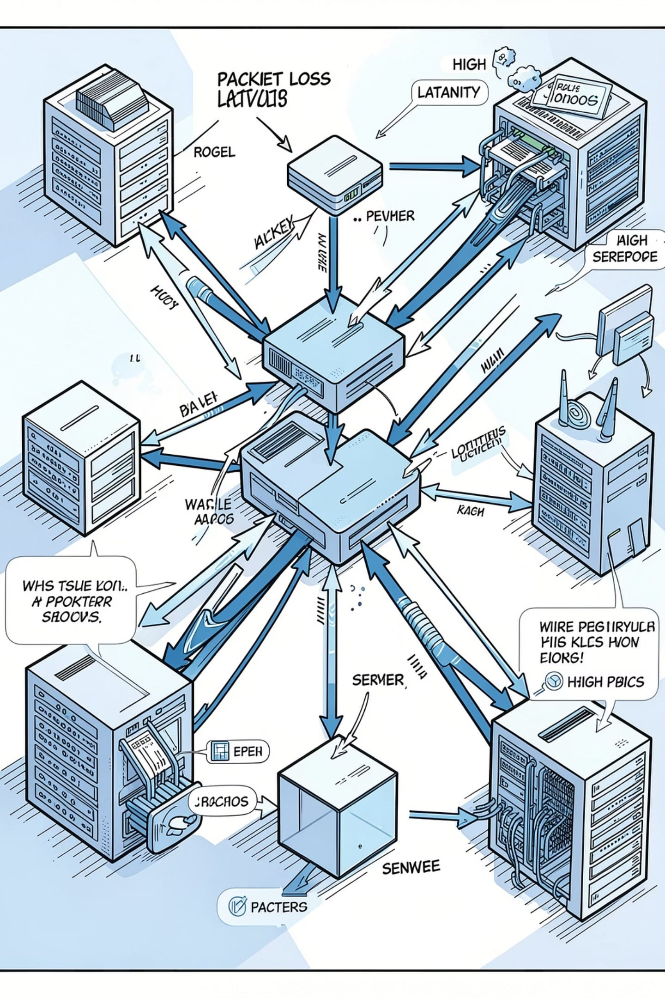
Introduction — What is Network Error Detection?
Detecting faults and anomalies in packet delivery and link behavior
Key goal: maintain reliability, performance, and security
Common errors: packet loss, bit errors, congestion, link failure, high latency
Traditional methods are rule-based and detect known patterns only

Slide 3
Traditional Error Detection Techniques
Parity check — simple bit parity for single-bit errors
Checksum — sum-based integrity checks for packets
CRC — polynomial remainder method for robust error detection
Hamming code — error-correcting codes for limited-bit recovery
Advantages
Limitations
Low overhead, deterministic, hardware-friendly
Detects known errors only, limited context awareness, poor anomaly prediction
Method
Detects
Strength
Weakness
Parity
Single-bit flips
Very simple
Can't locate errors
Checksum
Packet corruption
Efficient
Collision-prone
CRC
Burst errors
High detection rate
Complexer hardware
Hamming
Correctable bit errors
Error correction
Overhead for parity bits

Slide 4


Introduction to Machine Learning
What is ML? Algorithms that learn patterns from data to make predictions or decisions
Types: Supervised, Unsupervised, Reinforcement
Why ML for networking: detect complex patterns, adapt over time, reduce manual rules
Data
Model Training
Evaluation
Deployment

Slide 5
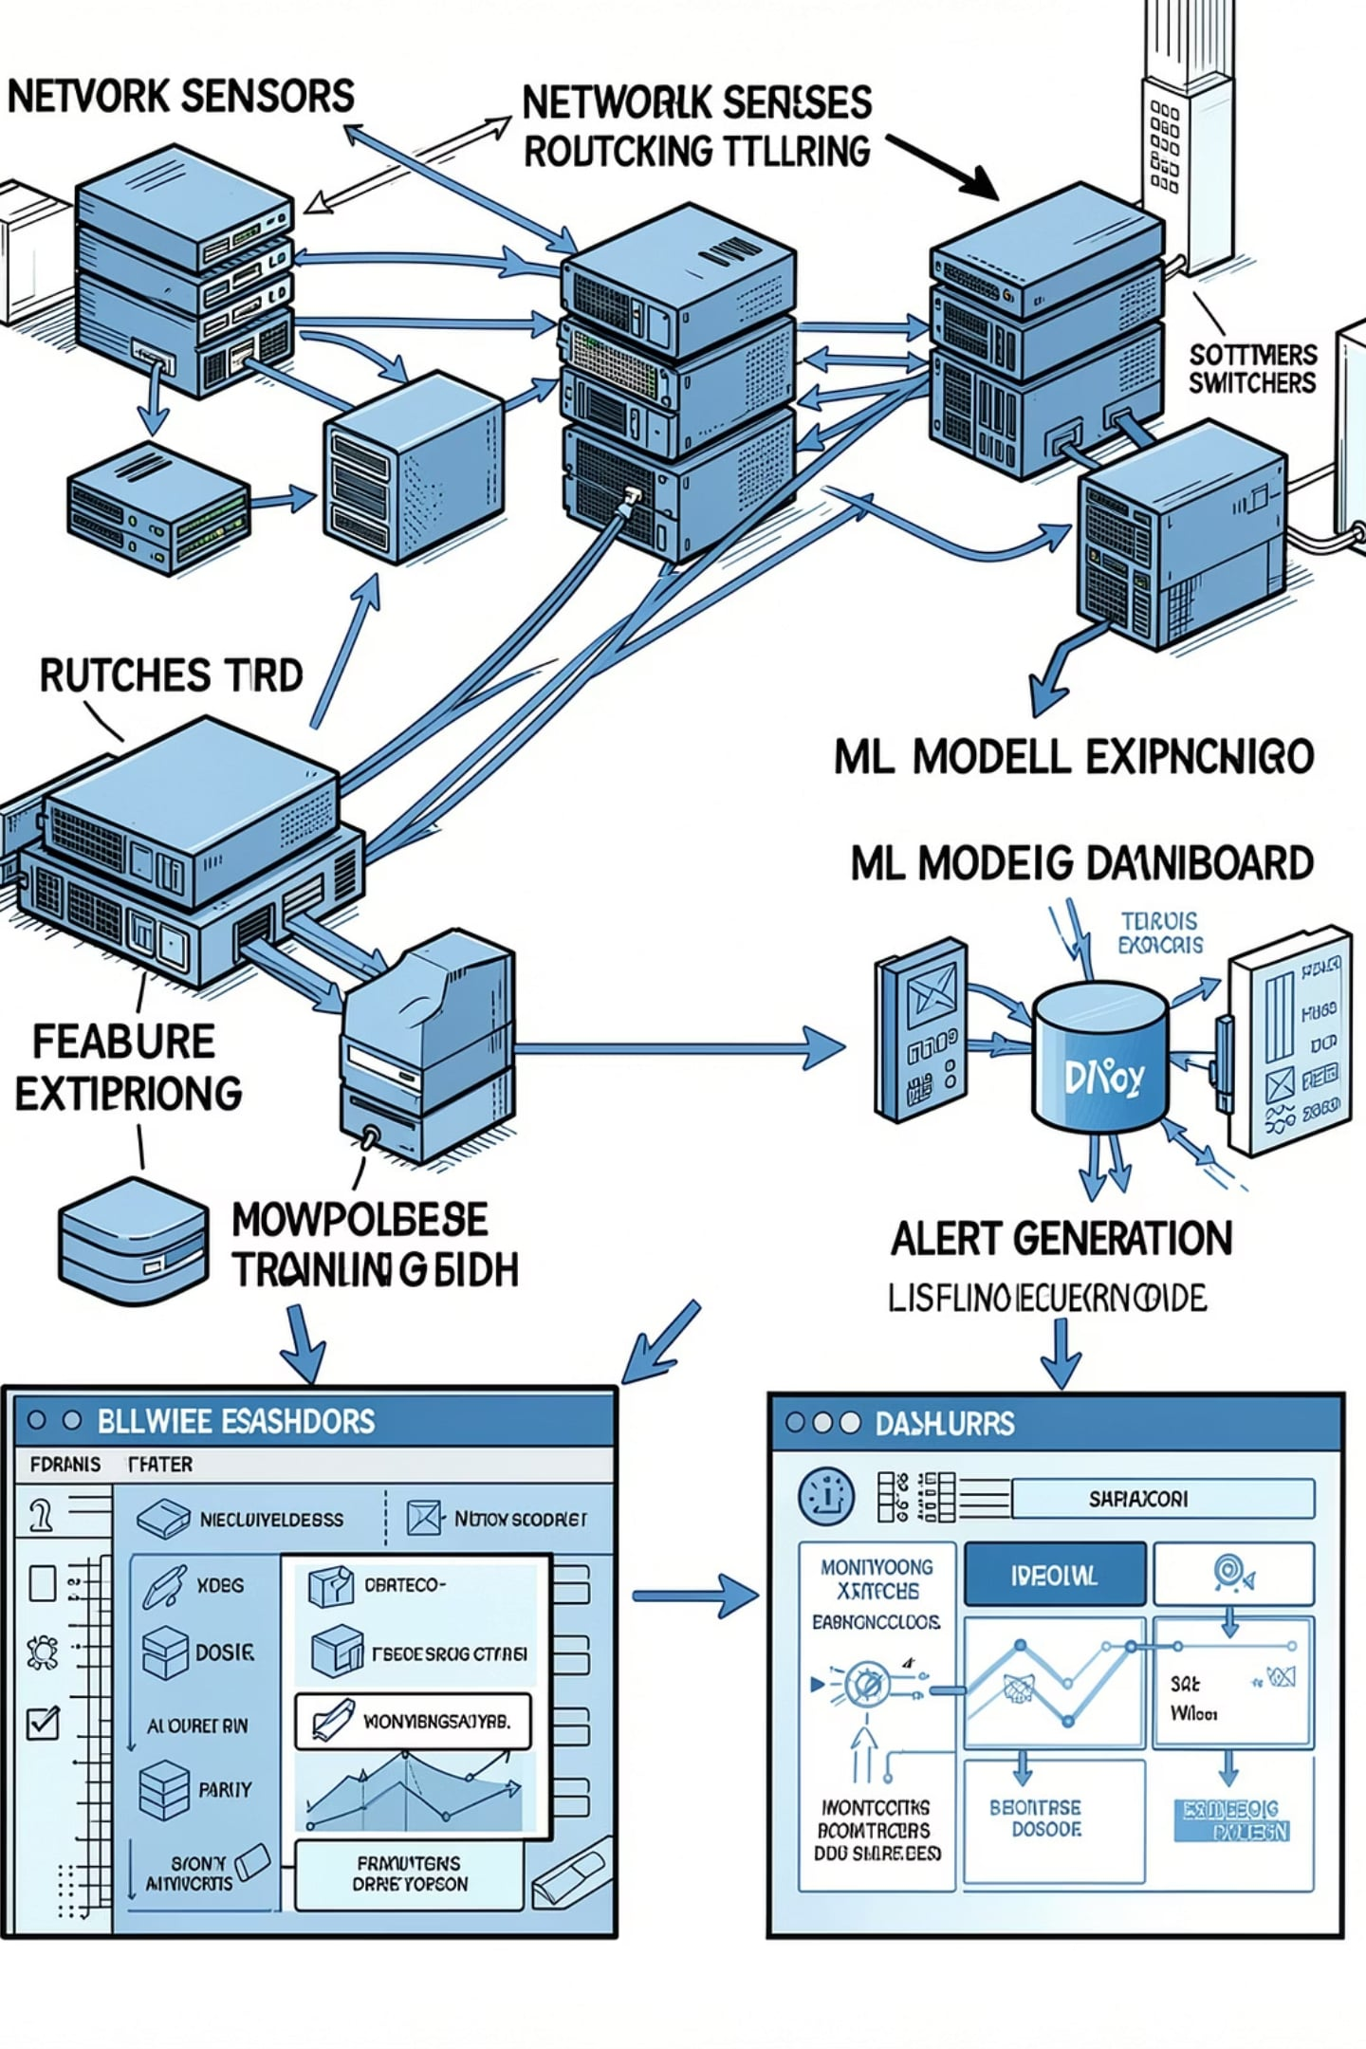
ML-Based Error Detection — End-to-End Process
Network data collection (flow logs, SNMP, telemetry)
Feature extraction (latency, packet loss rate, jitter, queue sizes)
ML model training (labeled or unsupervised)
Real-time monitoring & inference
Error detection → alert generation → remediation trigger

Slide 6




Algorithms Commonly Used
Decision Tree
Decision Tree — interpretable classification
Random Forest — ensemble, robust to noise
SVM — margin-based classification for smaller feature sets
Neural Networks / Deep Learning — capture complex, non-linear behaviors
Isolation Forest — unsupervised anomaly detection
Fast, interpretable
Random Forest
High accuracy, less overfitting
Neural Networks
Learn complex correlations
Isolation Forest
Unsupervised anomaly detection
Algorithm
Strength
Best Use
Decision Tree
Interpretable
Feature-rich labeled data
Random Forest
Generalizes well
Mixed data; noisy environments
SVM
Effective in high-dim small datasets
Binary anomaly detection
Neural Networks
Model complex patterns
Large-scale telemetry
Isolation Forest
No labeled data needed
Novel anomaly detection

Slide 7



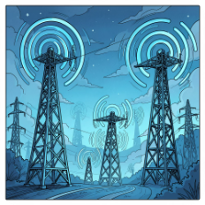
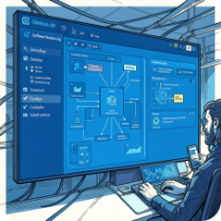
Applications of ML Error Detection
Data Centers
Cloud Computing
IoT Networks
Wireless & 5G
Detect server/network anomalies, optimize load balancing
Detect faulty sensors and connectivity problems
Auto-scale and preempt outages via anomaly alerts
Optimize handovers, identify interference
SDN
Programmatic routing adjustments on detected faults

Slide 8
Advantages
Challenges
Higher accuracy for complex anomalies
Early detection with predictive signals
Real-time monitoring & adaptive learning
Reduces manual troubleshooting
Requires large, labeled datasets
High computational and storage cost
Risk of false positives / alert fatigue
Model training time and privacy concerns

Slide 9
Case Study & Future Scope
Case Study (Cloud Data Center)
Problem: intermittent link anomalies causing service degradation
Solution: telemetry + Isolation Forest for anomaly flagging; Random Forest for classification
Results: Accuracy 95%; Detection time reduced by 60%; Downtime reduced significantly
Future Directions
AI-driven self-healing networks
Explainable AI (XAI) for operator trust
Edge AI for low-latency inference
Integration with 6G & autonomous network management

Slide 10
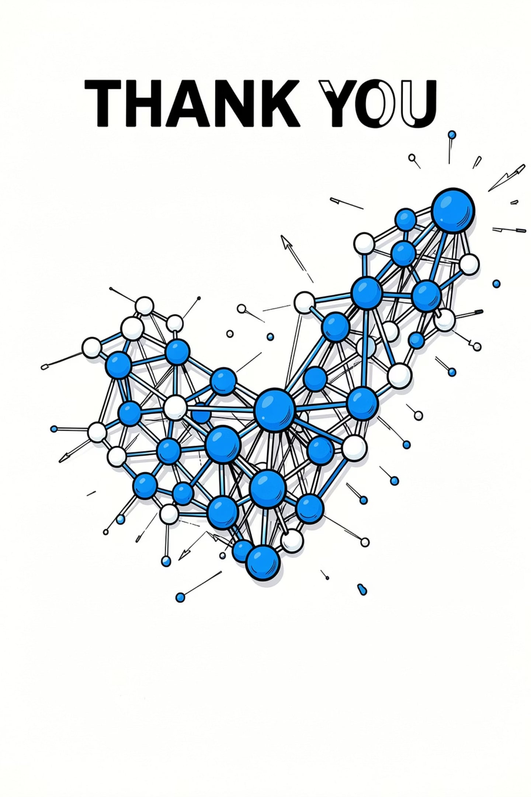
Conclusion
Traditional methods are necessary but limited to known errors
Machine Learning enables prediction and detection of hidden anomalies
ML improves reliability, enables proactive remediation, and scales with telemetry
Future networks will rely on explainable, distributed AI for autonomy
Thank you

